Slide 1
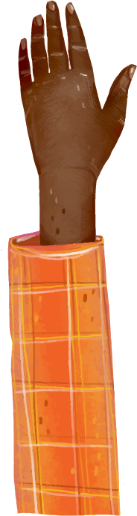
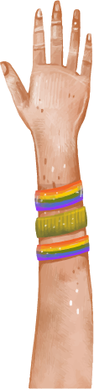



Diversity and Inclusion Extended Prayer

Slide 2
01
Code Switch
Take the time to code switch, such as moving the tables and chairs and sitting on the floor.

Slide 3
02
Readers
Get some volunteer readers - 4 is ideal.

Slide 4
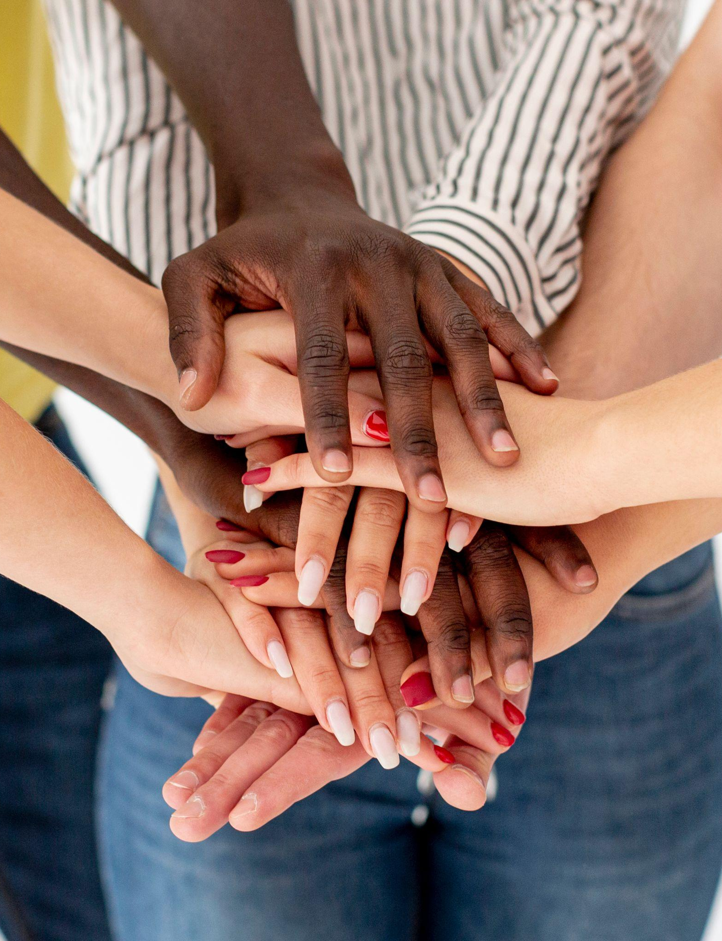
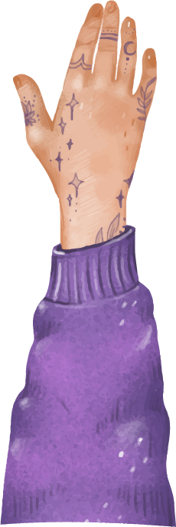
Warning
This is an extended prayer on the topic of diversity and inclusion.
If you have ever experienced discrimination, this may be triggering for you.
Just let your tutor know if you are uncomfortable and you can leave to go to the planning room if this happens.

Slide 5


Reader 1: Acknowledgement of Country
We acknowledge the traditional owners and custodians of the land on which we gather, the First Nations people.
We pay our respects to Elders past and present.
We honour their links to all creation.
May we walk gently together in reconciliation and peace.

Slide 6
Reader 2: Breathing
At this moment we take time to pause and remember we are in the presence of God.
To prepare for prayer, let us take a moment to become aware of your breathing…
don’t change your breathing…just notice your breathing going in and out.
Notice the rise and fall of your chest.
If you become aware of thinking about things – notice them and let them pass away and just notice your breath again.

Slide 7
Reader 3:
Why is respect for diversity important in the Catholic faith?
One of the foundational beliefs of Christianity is the trinity.
The Father, Son and Holy Spirit are all God, yet clearly different and we embrace these differences.
Notes:
https://cac.org/daily-meditations/the-delight-of-diversity-2016-09-20/

Slide 8
Reader 4:
The 3 persons of the one God, the Trinity, symbolises unity in diversity.
Richard Rohr, a Franciscan (Catholic) Priest, explains his understanding of the trinity in his quote on the next slide.
Notes:
https://cac.org/daily-meditations/the-delight-of-diversity-2016-09-20/

Slide 9
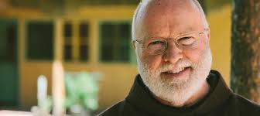
Reader 1:
“The Trinity reveals a pattern of perfect freedom whereby each of the Three Persons allows the other Two to be fully themselves and …while still allowing, protecting, and honoring itself as itself, and forever emptying itself of itself to make room for the other Two”.
Richard Rohr
Teacher - ask the students to give their ideas of what they think this quote means.
https://cac.org/daily-meditations/the-delight-of-diversity-2016-09-20/

Slide 10
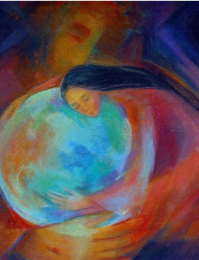
Reader 2:
Some of your conversations may have included things like…
God created us to have freedom of choice.
God want us to just be who we are, and be fully ourselves.
God wants us to make room for difference.

Slide 11
Reader 3:
In the Catholic tradition, we always look to the model of Jesus to guide us in our thinking.
Jesus said….
“There are many rooms in my Father's house. I wouldn't tell you this, unless it was true. I am going there to prepare a place for each of you.” (John 14:2).

Slide 12
Reader 4:
Teacher - ask the students to give their ideas of what they think this bible quote means.
This does not mean that God’s house literally is like a mansion.
To take the bible seriously, we must not interpret it literally.
So what do you think Jesus meant?
No, that is not what it means at all.
“There are many rooms in my Father's house. I wouldn't tell you this, unless it was true. I am going there to prepare a place for each of you.” (John 14:2).

Slide 13
Reader 1:
Some of your conversations may have included things like…
Jesus is telling us that there is room for everyone in God’s house
No-one is excluded from God’s love

Slide 14
On the next slide, we will listen to a Priest and a lay person from a Catholic University in America talk about the importance of diversity and inclusion.
The messages they are talking about are just as relevant for a school as they are a university!
Reader 2:

Slide 15

Diversity, Equity and Inclusion Video - stops at 1 min 56 sec
https://www.youtube.com/watch?v=2TmLKaOAtu8&t=1s

Slide 16
So, in our College, as a college striving to follow in the footsteps of Jesus, we must aim to respect the dignity of every person in our school.
We must say ‘NO’ to all forms of discrimination that causes suffering or harm to any other person.
Reader 3:

Slide 17
Jesus invited all to his table, especially the marginalised.
If we are to act like Jesus…we must do the same.
With this in mind, on Friday you will notice some staff in our school wearing a sticker of solidarity with a marginalised group.
Reader 4:

Slide 18

Reader 1:
Some of our staff (who are in the Independent Education Union) may be wearing this sticker in solidarity with LGBTQIA+ people, as this Friday is IDAHOBIT, the International Day Against Homophobia, Biphobia, Interphobia and Transphobia.

Slide 19
LGBTQIA+ people in Australia today still experience disproportionate rates of bullying, harassment and discrimination, with two in three LGBTQIA+ youth experiencing abuse due to their identity and 35% of LGBTQIA+ Australians reporting verbal abuse within the past twelve months.
Reader 2: Some statistics…
https://www.idahobit.org.au/

Slide 20
Remember….God’s love is not limited to any particular group of people.
God’s love is limitless and overflowing.
Each human person is made in the image and likeness of God and therefore we need to treat each other with utmost dignity and respect.
Let us finish by saying a prayer of inclusion.
Reader 3: Responding to God’s call

Slide 21
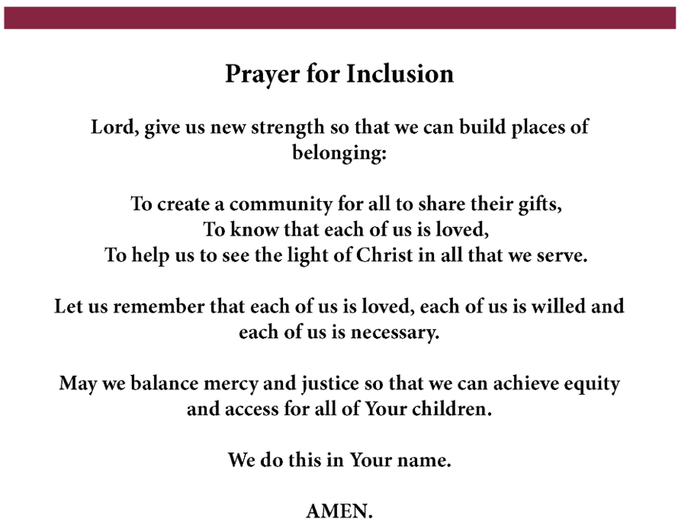
Reader 4
https://www.luc.edu/media/lucedu/ccse/pdfs/PRAYER%20for%20Inclusion.pdf
Notes:
https://www.luc.edu/media/lucedu/ccse/pdfs/PRAYER%20for%20Inclusion.pdf

Slide 22
Thank You!
Notes:
https://www.youtube.com/watch?v=_ItQVlyXjd4
https://www.youtube.com/watch?v=2TmLKaOAtu8

